Slide 1
Search Algorithms
Understanding search problems, concepts, & solving search problems.

Slide 2
Introduction
In this chapter, we're going to talk about search problems—how they are defined, analyzed, and solved. At their core, search problems are about finding a path from an initial state to a goal state, navigating through a space of possibilities using various strategies.
We'll explore key concepts like state spaces, actions, and path costs, then dive into classical search algorithms such as Depth-First Search (DFS) and Breadth-First Search (BFS). As we progress, we'll also examine heuristic approaches like Greedy Best-First Search and adversarial search techniques like Minimax with Alpha-Beta Pruning.
Whether it's solving puzzles, optimizing routes, or making AI-driven decisions in games, understanding search problems is fundamental to artificial intelligence and computational problem-solving.

Slide 3
Introduction
By the end of this course, you'll be able to:
Define and analyze search problems, identifying key components such as initial states, goal states, state spaces, and actions.
Implement fundamental search algorithms, including Depth-First Search (DFS) and Breadth-First Search (BFS).
Optimize search strategies using heuristic-based methods like Greedy Best-First Search.
Apply adversarial search techniques, including the Minimax algorithm with Alpha-Beta Pruning.
Develop intelligent systems capable of decision-making in competitive environments..

Slide 4
01
Understanding Search Problems

Slide 5
Understanding Search Problems
A search problem is a computational problem where an agent must find a sequence of actions that lead from an initial state to a goal state. Identifying a search problem involves recognizing:
Initial State: Where the search begins.
Goal State: The desired outcome.
State Space: The set of all possible states.
Actions: Possible moves or transitions.
Path Cost: The cost associated with a sequence of actions.
Concepts
Agent: An entity making decisions to solve the search problem
State: A representation of a configuration in the problem space.
Actions: The possible moves the agent can take from a given state.

Slide 6
Solving Search Problems
Solution and Optimal Solution
A solution to a search problem is a sequence of actions leading from the initial state to the goal state. The optimal solution is the one with the least cost or shortest path.

Slide 7
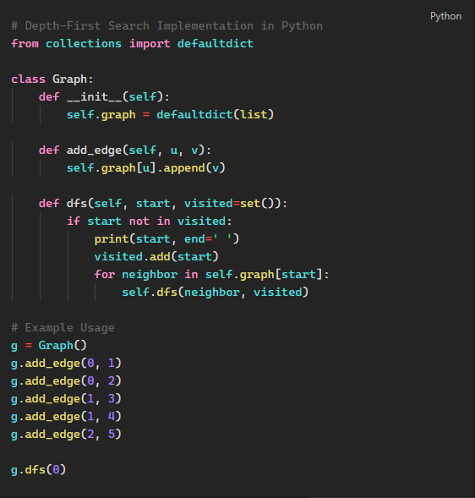
Depth-First Search (DFS)
DFS explores as far down a branch as possible before backtracking.
Algorithm:

Slide 8
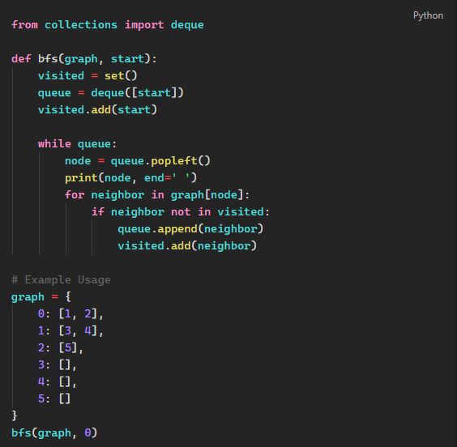
Breadth-First Search (BFS)
BFS explores all neighbors of a node before moving to the next level.

Slide 9
Greedy Best-First Search
This heuristic-based search prioritizes nodes based on an estimated cost function.
Algorithm (Pseudocode):
Initialize an open list with the start node.
Remove the node with the lowest heuristic value.
If the node is the goal, return the path.
Expand the node’s neighbors and add them to the open list.
Repeat until a solution is found.

Slide 10
Adversarial Search (Game Playing)
Adversarial search is used in games where opponents compete.
Minimax Algorithm
- Minimax is used in two-player games to minimize the opponent’s maximum possible gain.

Slide 11
Alpha-Beta Pruning (α-β Pruning)
Alpha-beta pruning is an optimization technique for the Minimax algorithm, which is used in decision-making and game theory (e.g., chess, tic-tac-toe). The goal of alpha-beta pruning is to reduce the number of nodes evaluated in the minimax tree by "pruning" branches that will not affect the final decision.
How it Works-
- Alpha (α) represents the best (highest) value a maximizing player can guarantee.
Beta (β) represents the best (lowest) value a minimizing player can guarantee.
During tree traversal, if we find a move that guarantees a worse outcome than a previously evaluated move, we stop evaluating that branch.
This pruning helps the algorithm ignore parts of the tree that do not influence the final result, reducing the number of computations.

Slide 12
Depth-Limited Minimax
Depth-limited minimax is a variation of the Minimax algorithm that limits the depth of the search tree to a fixed value. Instead of exploring the entire game tree to determine the best possible move, the algorithm only searches up to a specific depth and uses a heuristic evaluation to estimate the value of leaf nodes beyond that depth.
This approach is useful in games where the state space is large, and exploring the entire tree is computationally expensive or impractical. By setting a fixed depth limit, you can balance between computation time and strategic depth (the number of moves ahead considered by the algorithm).

Slide 13


